Slide 1
Maya Python Scripting Exercises

Slide 2
Command framework scripts

Slide 3
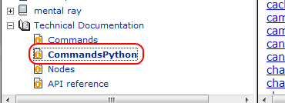
Review
Prefix all Python scripts with import maya.cmds as cmds
If you get confused by the Python syntax, refer to the Python version of the command docs:

Slide 4
Convert the MEL below to Python:
polyPlane -w 2 -h 2 -n plane;
select -r plane;
ls -sl;
cmds.polyPlane( w=2, h=2, n='plane' )
cmds.select( 'plane', r=True )
print cmds.ls( sl=True )

Slide 5
Convert the MEL below to Python:
string $plane[] = `polyPlane -w 2 -h 2`;
string $polyPlane = $plane[1];
setAttr ($polyPlane+".subdivisionsWidth") 20;
plane = cmds.polyPlane( w=2, h=2 )
polyPlane = plane[1]
cmds.setAttr( polyPlane+'.subdivisionsWidth', 20 )

Slide 6
Convert the MEL below to Python:
string $plane[] = `polyPlane -w 2 -h 2`;
string $sphere[] = `polySphere -r 2`;
string $all[] = `stringArrayCatenate $plane $sphere`;
for ( $i=0; $i<size($all); $i++ )
{
print( $i + ": " + $all[$i] + "\n" );
}
plane = cmds.polyPlane( w=2, h=2 )
sphere = cmds.polySphere( r= 2 )
all = plane + sphere
for i, v in enumerate( all ):
print i, ": ", v

Slide 7
Convert the MEL below to Python:
proc makeSphere( float $x )
{
string $sphere[] = `polySphere -r 1`;
move -a $x 0 0 $sphere[0];
}
int $i;
for ( $i=0; $i<10; $i++ )
{
makeSphere( $i * 2.0 );
}
def makeSphere( x ):
sphere = cmds.polySphere( r=1 )
cmds.move( x, 0, 0, sphere[0], a=True )
for i in range(10):
makeSphere( i * 2.0 )

Slide 8
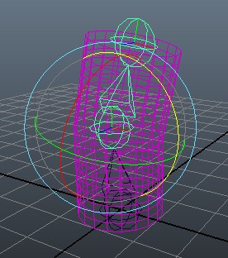
Skinning script
Write a script to make a cylinder and a simple three bone skeleton. Bind the mesh to the lower two joints only and create a simple animation.
cyl = cmds.polyCylinder( h=4, sh=20 )
cmds.move( 0, 2, 0 )
cmds.select( cl=True )
joint1 = cmds.joint( p=(0,0,0) )
joint2 = cmds.joint( p=(-0.2,2,0) )
joint3 = cmds.joint( p=(0,4,0) )
cmds.select( [joint1,joint2,cyl[0]], r=True )
cmds.bindSkin( toSelectedBones=True )
cmds.select( joint2, r=True )
cmds.currentTime( 1 )
cmds.setKeyframe()
cmds.currentTime( 25 )
cmds.rotate( 0, 0, 50 )
cmds.setKeyframe()

Slide 9
Skinning script
Let’s make that more “Python-y”.
cyl = cmds.polyCylinder( h=4, sh=20 )
cmds.move( 0, 2, 0 )
cmds.select( cl=True )
joints = [ cmds.joint( p=x ) for x in [ (0,0,0), (-0.2,2,0), (0,4,0) ] ]
cmds.select( joints[0:1] + [cyl[0]], r=True )
cmds.bindSkin( toSelectedBones=True )
cmds.select( joints[1], r=True )
for time, value in zip( [1, 25], [0, 50] ):
cmds.currentTime( time )
cmds.rotate( 0, 0, value, a=True )
cmds.setKeyframe()

Slide 10
Simple class
Write a simple class representing a poly sphere.
Creating a class instance should create a sphere in Maya. Give the class setRadius() and getRadius() methods.
class sphere():
def __init__( self, radius=None ):
self.nodes = cmds.polySphere()
if radius != None:
self.setRadius( radius )
def setRadius( self, radius ):
cmds.setAttr( self.nodes[1] + '.r', radius )
def getRadius( self ):
return cmds.getAttr( self.nodes[1] + '.r' )
s1 = sphere()
s1.setRadius( 4.0 )
s2 = sphere( 3.0 )
print s2.getRadius()

Slide 11


